Slide 1




Slide 2







TOPIC -1
Brief review of Number
Number systems and Logic Families
Systems
Digital Logic Gates
and its
electrical characteristics
Review of RTL, DTL, TTL, ECL, CMOS families.
2

Slide 3




3

Slide 4

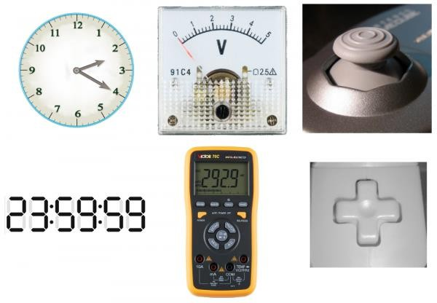
INTRODUCTION TO DIGITAL SYSTEMS
ANALOG vs DIGITAL SYSTEMS

Slide 5
INTRODUCTION TO DIGITAL SYSTEMS
INTRODUCTION
In electronics is important when dealing with various quantities that we be able to represent their values efficiently and accurately.
Electronic circuits can be divided into two broad categories, digital and analog.
The major difference between analog and digital quantities, then, can be stated simply as follows:
  Analog = continuous
  Digital = discrete (step by step)

Slide 6
INTRODUCTION TO DIGITAL SYSTEMS
ANALOG SYSTEMS
Systems which are capable of processing a continuous range of values varying with respect to time are called analog systems.
Most things that can be measured quantitatively occur in nature in analog form.
Analog quantities have an important characteristic: they can vary over a continuous range of values.

Slide 7
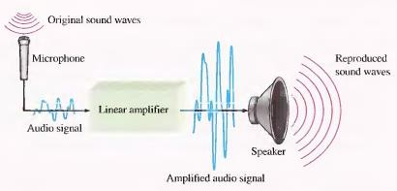
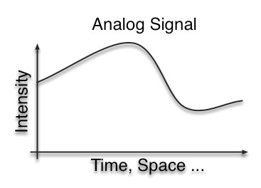
INTRODUCTION TO DIGITAL SYSTEMS
ANALOG SYSTEMS

Slide 8
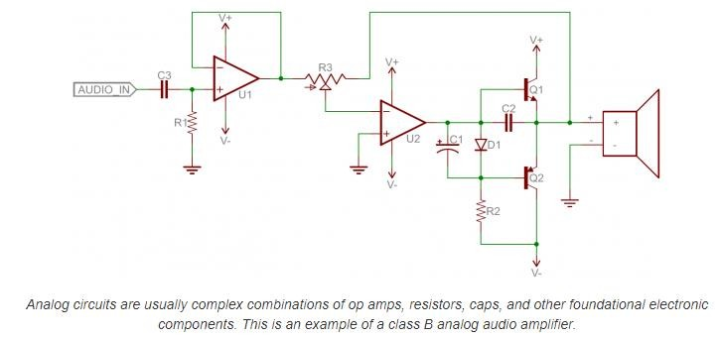
INTRODUCTION TO DIGITAL SYSTEMS
ANALOG CIRCUITS

Slide 9
INTRODUCTION TO DIGITAL SYSTEMS
DIGITAL SYSTEMS
A digital quantity is one having a discrete set of values. Systems which process discrete values are called digital systems.
In digital representation the quantities are represented not by proportional quantities but by symbols called digits.
For many years, applications of digital electronics were confined to computer systems. Today, digital technology is applied in a wide range of areas in addition to computers.

Slide 10
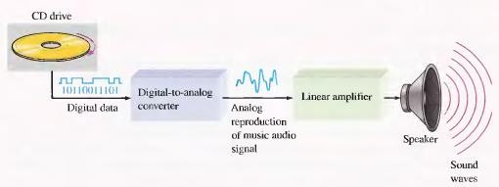
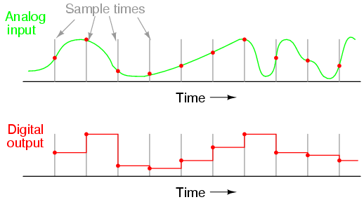
INTRODUCTION TO DIGITAL SYSTEMS
DIGITAL SYSTEMS

Slide 11
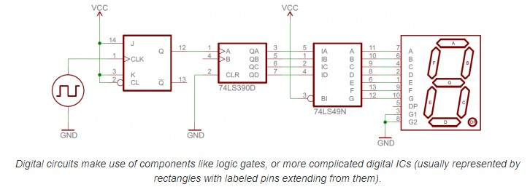
INTRODUCTION TO DIGITAL SYSTEMS
DIGITAL CIRCUITS

Slide 12
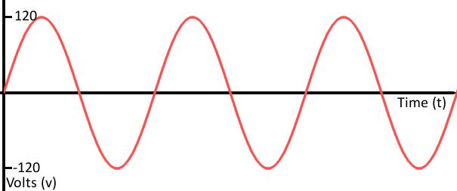
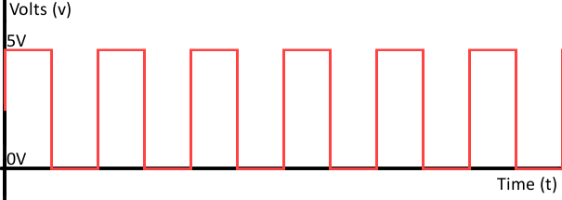
INTRODUCTION TO DIGITAL SYSTEMS
ANALOG vs DIGITAL SIGNALS
Analog waves are smooth and continuous,
digital are
waves stepping,
square, and discrete

Slide 13
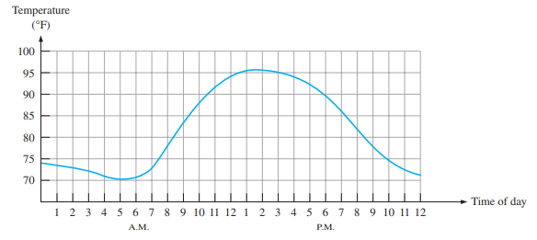
INTRODUCTION TO DIGITAL SYSTEMS
ANALOG vs DIGITAL SIGNALS
For example, the air temperature changes over a continuous range of values. During a given day, the temperature does not go from, say, 70 to 71 instantaneously; it takes on all the infinite values in between.

Slide 14
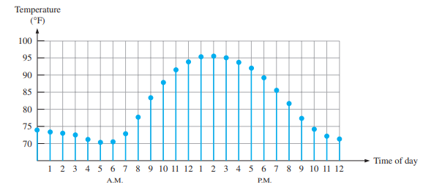
INTRODUCTION TO DIGITAL SYSTEMS
ANALOG vs DIGITAL SIGNALS
Rather than graphing the temperature on a continuous basis, suppose you just take a temperature reading every hour. Now you have sampled values representing the temperature at discrete points in time (every hour) over a 24-hour period.

Slide 15
INTRODUCTION TO DIGITAL SYSTEMS
DIGITAL SYSTEMS ADVANTAGES
Easier to design.
Information storage is easy.
Digital circuits are less affected by noise.
Exact values are not important, only the range (HIGH or LOW) in which they fall.
More digital circuitry can be fabricated on IC chips.
Applications: communications systems, navigation, military systems,
radar, medical
instrumentation, industrial process control.

Slide 16


Slide 17

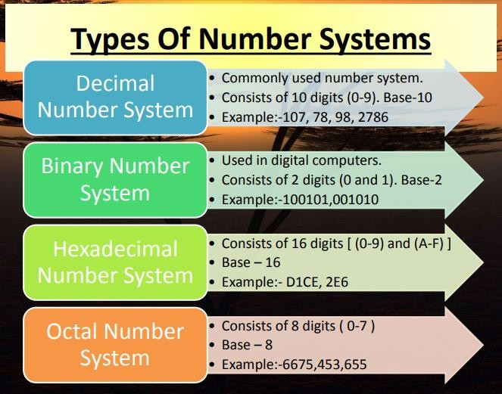
NUMBER BASE CONVERSIONS
NUMBER SYSTEMS

Slide 18
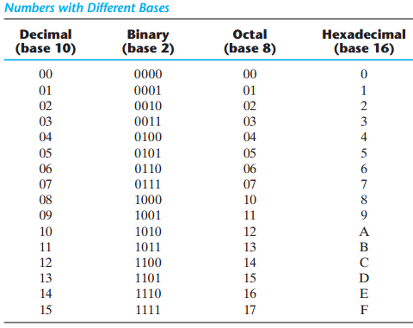
NUMBER BASE CONVERSIONS
NUMBER SYSTEMS

Slide 19
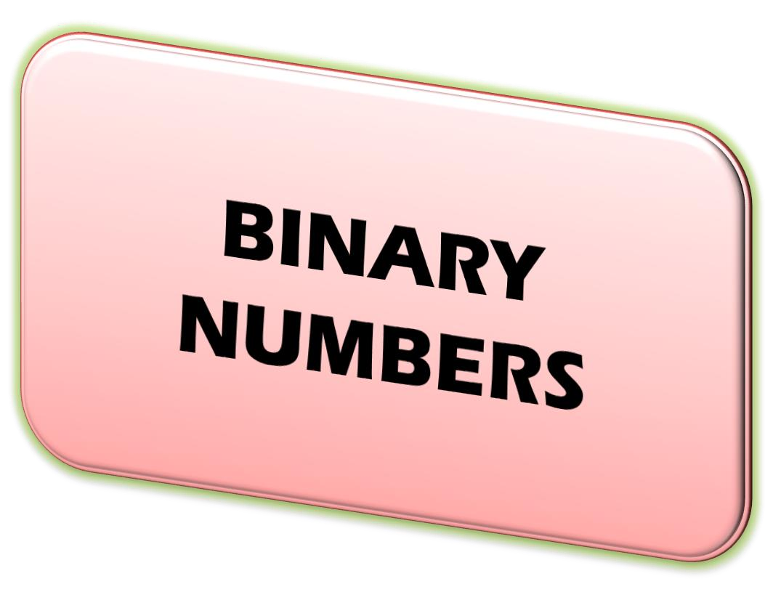

Slide 20

BINARY NUMBERS
BINARY NUMBER SYSTEMS
The binary number system has two digits (bits 0 &1)
The binary number system has a base of 2
The position of a 1 or 0 in a binary number indicates its weight. or value within the number
The weights in a binary number are based on powers of 2
In general, with n bits you can count up to a number equal to 2^{n} – 1

Slide 21

BINARY NUMBERS
BINARY NUMBER SYSTEMS
The weight or value of a bit increases from right to left in a binary number.
A binary number is a weighted number
The right-most bit is the LSB (least significant bit) and left-most bit is the MSB (most significant bit)
Fractional numbers can also be represented in binary by placing bits to the right of the binary point

Slide 22

BINARY NUMBERS
BINARY NUMBER SYSTEMS
All the bits to the left of the binary point have weights that are positive powers of two
All bits to the right of the binary point have weights that are negative powers of two
The weight doubles for each positive power of two and that the weight is halved for each negative power of two

Slide 23
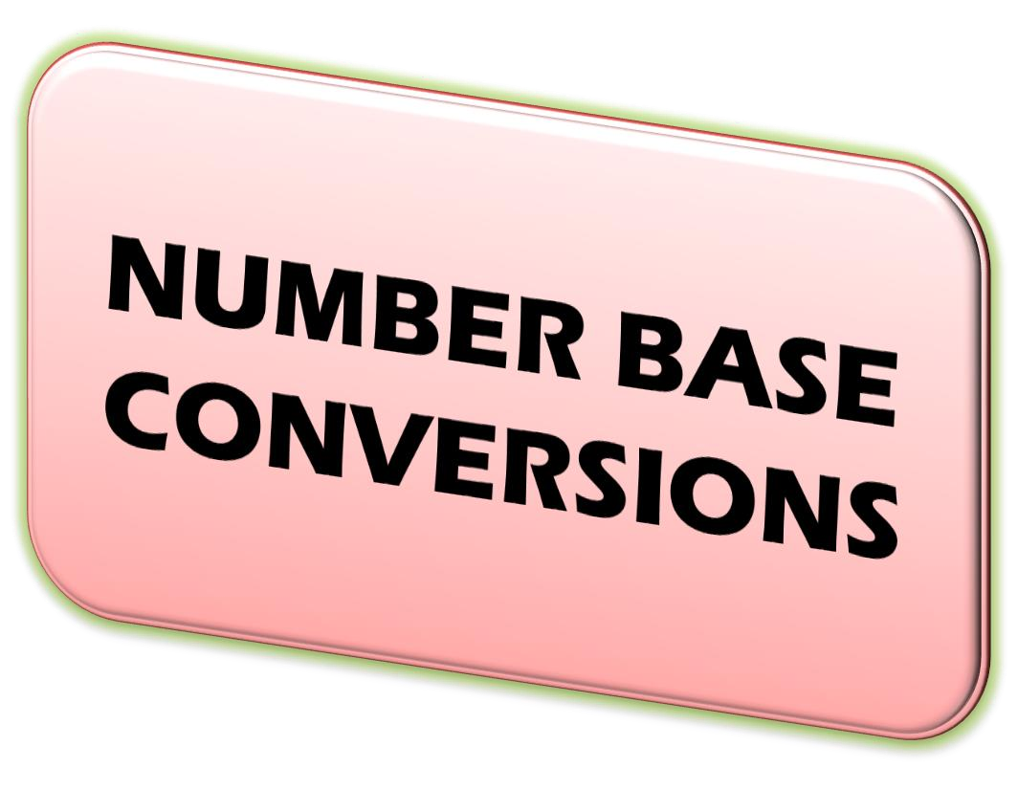

Slide 24
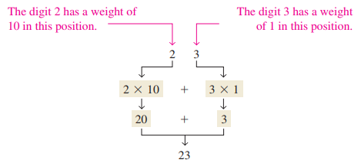

NUMBER BASE CONVERSIONS
DECIMAL NUMBER SYSTEMS
Decimal number system has ten digits (0 to 9)
The decimal number system has the base of 10
The value of the digit is determined by the position of the number

Slide 25

NUMBER BASE CONVERSIONS
DECIMAL NUMBER SYSTEMS
Express the decimal number 568.23 as a sum of the values of each digit.

Slide 26

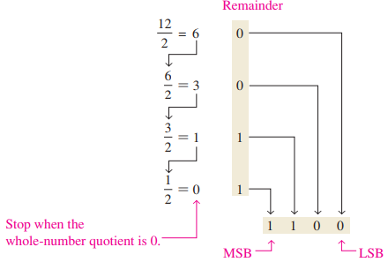
NUMBER BASE CONVERSIONS
DECIMAL to BINARY CONVERSION
(Repeated division by 2 method)
To get the binary number for a given decimal number, divide the decimal number by 2 until the quotient is 0. Remainders form the binary number.

Slide 27












NUMBER BASE CONVERSIONS
DECIMAL TO BINARY CONVERSION
(156)₁₀ = (10011100)₂

Slide 28
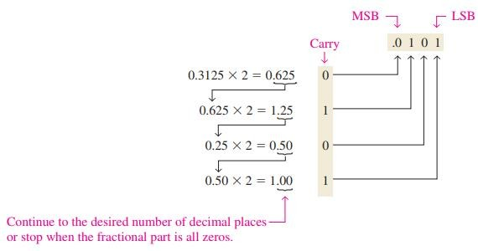
NUMBER BASE CONVERSIONS
DECIMAL to BINARY CONVERSION
(Repeated division by 2 method)

Slide 29
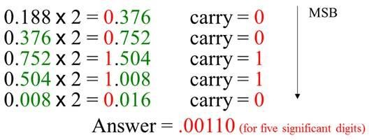
NUMBER BASE CONVERSIONS
DECIMAL TO BINARY CONVERSION (Fractional)
Convert (0.188)₁₀ to binary form

Slide 30
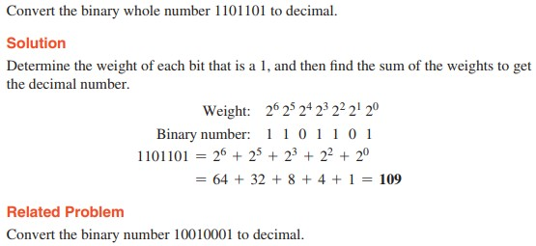
NUMBER BASE CONVERSIONS
BINARY to DECIMAL CONVERSION

Slide 31
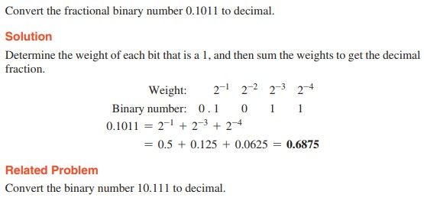
NUMBER BASE CONVERSIONS
BINARY to DECIMAL CONVERSION

Slide 32
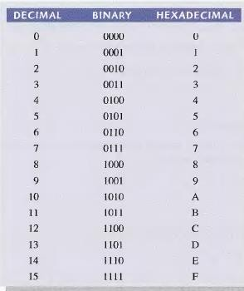
NUMBER BASE CONVERSIONS
HEXADECIMAL NUMBERS
The hexadecimal number system has a base of sixteen; it consists of digits 0-9 and letters A-F.

Slide 33
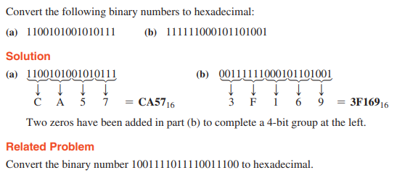
NUMBER BASE CONVERSIONS
BINARY to HEXADECIMAL CONVERSION
Simply break the binary number into 4-bit groups, starting at the right-most bit and replace each 4-bit group with the equivalent hexadecimal symbol.

Slide 34
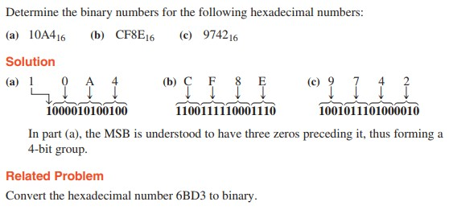
NUMBER BASE CONVERSIONS
HEXADECIMAL to BINARY CONVERSION
To convert from a hexadecimal number to a binary number, reverse the process and replace each hexadecimal symbol with the appropriate four bits.

Slide 35
NUMBER BASE CONVERSIONS
OCTAL NUMBER SYSTEMS
The octal number system has a base of 8
The octal number system is composed of eight digits, which are 0, 1, 2, 3, 4, 5, 6, 7
To count above 7, begin another column and start over: 10, 11, 12. 13, 14, 15, 16, 17, 20, 21,...
Counting in octal is similar to counting in decimal, except that the digits 8 and 9 are not used

Slide 36

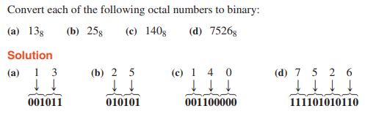
NUMBER BASE CONVERSIONS
OCTAL to BINARY CONVERSION
To convert an octal number to a binary number, simply
replace each octal digit with the appropriate three bits.

Slide 37
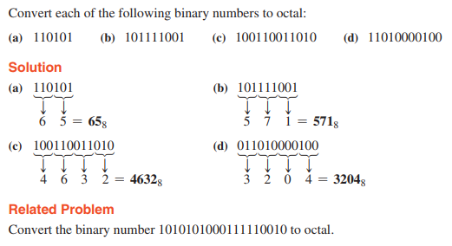
NUMBER BASE CONVERSIONS
BINARY to OCTAL CONVERSION
Conversion of a binary number to an octal number is the reverse of the octal-to-binary conversion.

Slide 38





NUMBER BASE CONVERSIONS
Exercise problems

Slide 39
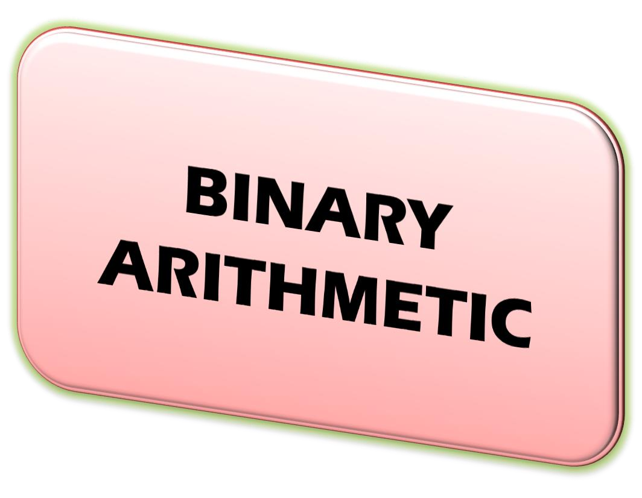

Slide 40

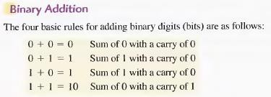
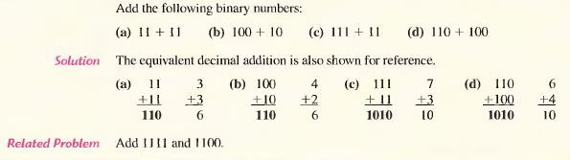
BINARY ARITHMETIC

Slide 41
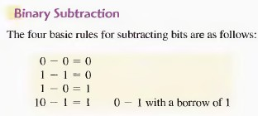
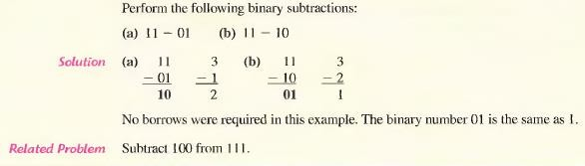
BINARY ARITHMETIC

Slide 42
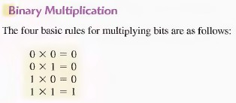
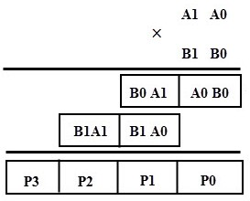
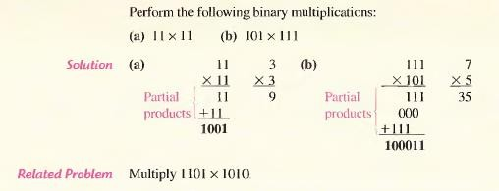
BINARY ARITHMETIC

Slide 43

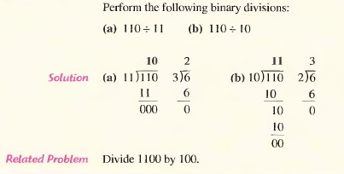
BINARY ARITHMETIC
BINARY ARITHMETIC

Slide 44


Slide 45

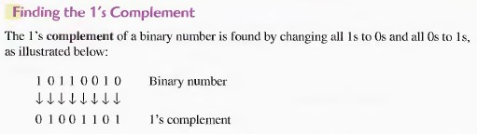
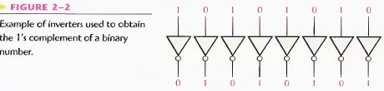
COMPLEMENTS
1’s COMPLEMENT OF BINARY NUMBER

Slide 46
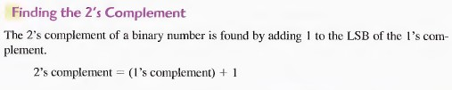
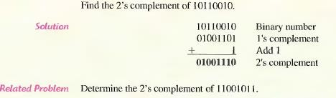
COMPLEMENTS
2’s COMPLEMENT OF BINARY NUMBER

Slide 47

COMPLEMENTS
2’s COMPLEMENT OF BINARY NUMBER

Slide 48
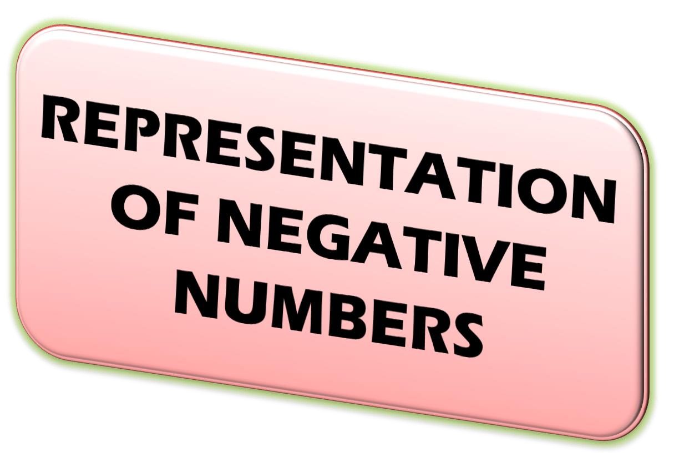

Slide 49

REPRESENTATION OF NEGATIVE NUMBERS
SIGNED MAGNITUDE NUMBERS
In decimal system, generally a plus (+) sign denotes a positive number whereas a minus (–) sign denotes a negative number. This type of representation of numbers is known as signed numbers.
But in digital circuits, there is no provision to put a plus or minus sign, normally an additional bit is used as the sign bit. This sign bit is usually placed as the MSB.
Generally a 0 is reserved for a positive number and a 1 is reserved for a negative number.

Slide 50
REPRESENTATION OF NEGATIVE NUMBERS
SIGNED MAGNITUDE NUMBERS
For example, an 8-bit signed binary number 01101001 represents a positive number whose magnitude is (1101001)₂= (105)₁₀ the MSB is 0, which indicates that the number is positive.
On the other hand, in the signed binary form, 11101001 represents a negative number whose magnitude is (11101001)₂= (-105)₁₀ . The 1 in the MSB position indicates that the number is negative and the other seven bits give its magnitude.
This kind of representation of binary numbers is called sign-magnitude representation.

Slide 51

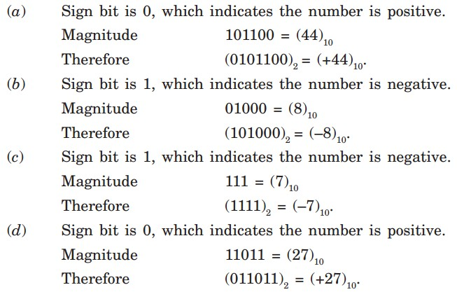
REPRESENTATION OF NEGATIVE NUMBERS
SIGNED MAGNITUDE NUMBERS

Slide 52


Slide 53

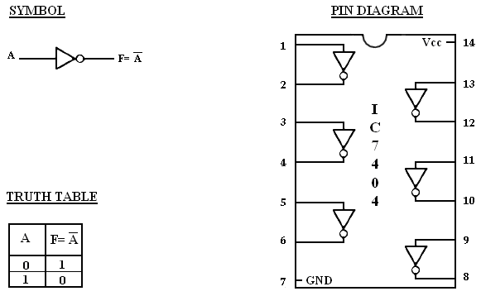
DIGITAL LOGIC GATES
NOT - LOGIC GATES

Slide 54
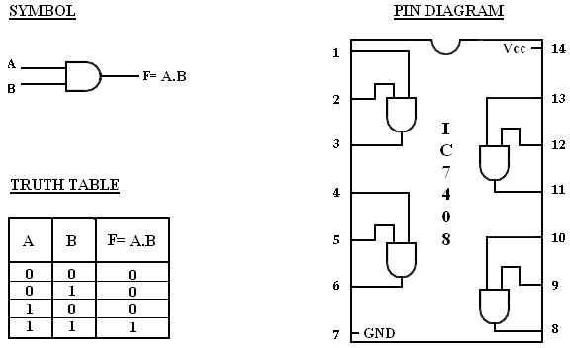
DIGITAL LOGIC GATES
AND - LOGIC GATES

Slide 55
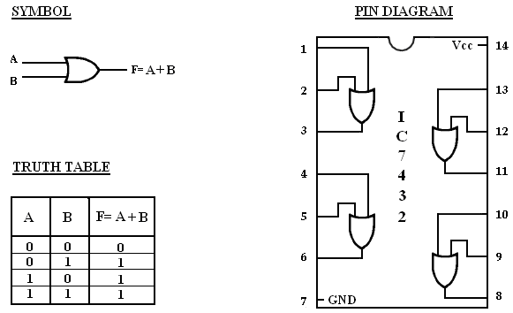
DIGITAL LOGIC GATES
OR - LOGIC GATES

Slide 56
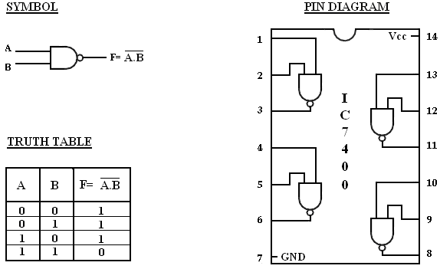
DIGITAL LOGIC GATES
NAND - LOGIC GATES

Slide 57
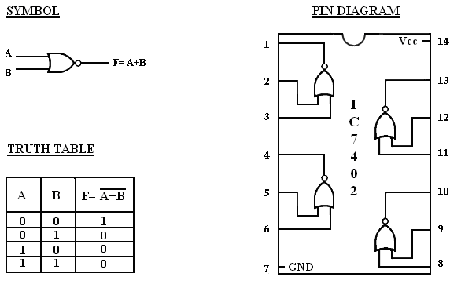
DIGITAL LOGIC GATES
NOR - LOGIC GATES

Slide 58
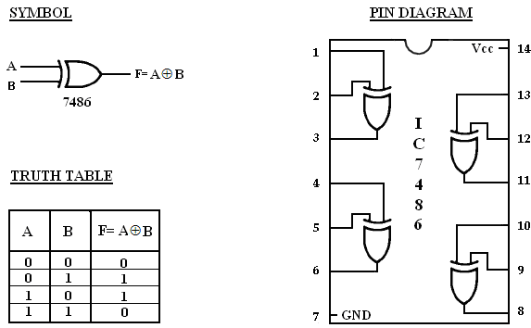
DIGITAL LOGIC GATES
XOR-LOGIC GATES

Slide 59


TOPIC -2
Basic Axiomatic Boolean
Definitions,
Definition of
Algebra, Basic
Boolean algebra
Theorems and Properties
of Boolean
Algebra, Functions, Standard
Boolean
Canonical and Forms
2

Slide 60


3

Slide 61


BOOLEAN ALGEBRA
BOOLEAN ALGEBRA INTRODUCTION
Boolean Algebra is the mathematics we use to analyze digital gates and circuits.
We can use these “Laws of Boolean” to both reduce and simplify a complex Boolean expression to reduce the number of logic gates required.
Boolean Algebra is therefore a system of mathematics based on logic that has its own set of rules or laws which are used to define and reduce Boolean expressions.
4

Slide 62




BOOLEAN ALGEBRA
LAWS OF BOOLEAN ALGEBRA
Commutative Laws: The commutative law of addition for two variables is written as:A+B=B+A
The commutative law of multiplication for two variables is, AB = BA
5

Slide 63



BOOLEAN ALGEBRA
LAWS OF BOOLEAN ALGEBRA
Associative Laws: The associative law of addition is written as follows for three variables:
A + (B + C) = (A + B) + C
The associative law of multiplication is written as follows for three variables:A(BC) = (AB)C
6

Slide 64
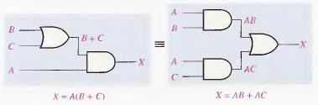

BOOLEAN ALGEBRA
LAWS OF BOOLEAN ALGEBRA
Distributive Law: The distributive law is written for three variables as follows:
A(B + C) = AB + AC
7

Slide 65
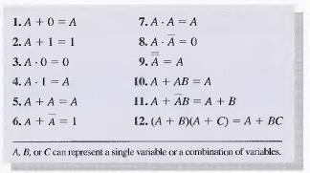

BOOLEAN ALGEBRA
RULES OF BOOLEAN ALGEBRA
Basic rules that are useful in manipulating and simplifying Boolean expressions.
8

Slide 66
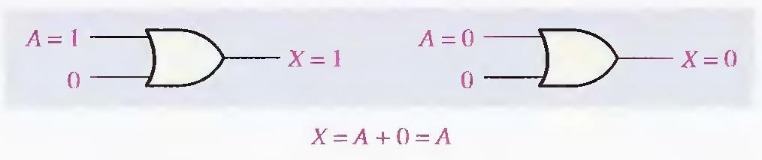



BOOLEAN ALGEBRA
RULES OF BOOLEAN ALGEBRA
RULE - 1
RULE - 2
RULE - 3

Slide 67




BOOLEAN ALGEBRA
RULES OF BOOLEAN ALGEBRA
RULE - 4
RULE - 5
RULE - 6

Slide 68




BOOLEAN ALGEBRA
RULES OF BOOLEAN ALGEBRA
RULE - 7
RULE - 8
RULE - 9

Slide 69



BOOLEAN ALGEBRA
RULES OF BOOLEAN ALGEBRA

Slide 70



BOOLEAN ALGEBRA
RULES OF BOOLEAN ALGEBRA

Slide 71



BOOLEAN ALGEBRA
RULES OF BOOLEAN ALGEBRA

Slide 72


BOOLEAN ALGEBRA
DEMORGAN’S LAW – FIRST LAW
The complement of a product of variables is equal to the sum of the complements of the variables
The formula for expressing this theorem for two variables is

Slide 73


BOOLEAN ALGEBRA
DEMORGAN’S LAW – SECOND LAW
The complement of a sum of variables is equal to the product of the complements of the variables.
The formula for expressing this theorem for two variables is

Slide 74



BOOLEAN ALGEBRA
DEMORGAN’S LAW – EXAMPLES

Slide 75

BOOLEAN ALGEBRA
MINIMIZATION OF BOOLEAN EXPRESSION
(x’+ y) (x+ y)
= x’.x+ x’y+ yx+ y.y
= 0+ x’y+ xy+ y
= y ( x’+ x+ 1)
= y( 1 )
= y.
[ x.x’= 0]; [ y. y= y]
[ 1+ x = 1 ]

Slide 76

BOOLEAN ALGEBRA
MINIMIZATION OF BOOLEAN EXPRESSION
xy+ xyz+ xyz’+ x’yz
= xy ( 1+ z+ z’)+ x’yz
= xy ( 1 ) + x’yz
= xy+ x’yz
= y ( x+ x’z )
= y ( x+ z ).
[ 1+ x = 1 ]
[ x+ x’y = x+ y]

Slide 77

BOOLEAN ALGEBRA
MINIMIZATION OF BOOLEAN EXPRESSION
x’yz+ xy’z’+ x’y’z’+ xy’z+ xyz
= yz (x’+x) + xy’z’+ x’y’z’+ xy’z
= yz (1) + y’z’ (x+ x’) + xy’z
= yz+ y’z’ (1) + xy’z
= yz+ y’z’+ xy’z
= yz+ y’ (z’+ xz)
[ x+ x’= 1]
[ x+ x’= 1]
= yz+ y’ (z’+ x) [ x’+ xy = x’+ y]
= yz+ y’z’+ xy’

Slide 78

BOOLEAN ALGEBRA
MINIMIZATION OF BOOLEAN EXPRESSION
xy+ xy’( x’z’)’
= xy+ xy’ (x’’+ z’’)
= xy+ xy’ (x+ z)
= xy+ xy’x+ xy’z
= xy+ xy’+ xy’z
= xy+ xy’ [1+ z]
= xy+ xy’ [1]
= xy+ xy’
= x( y+ y’)
= x [1]
= x
[x’’ = x]
[x. x= x]
[1+ x = 1]
[x+ x’= 1]

Slide 79

BOOLEAN ALGEBRA
MINIMIZATION OF BOOLEAN EXPRESSION
[(xy)’+ x’+ xy]’
= [ x’+ y’+ x’+ xy]’
= [ x’+ y’+ xy]’
= [x’+ y’+ x]’
= [y’+ 1]’
= [ 1 ]’
= 0.
[x+ x= x]
[ x’+ xy = x’+ y]
[ x+ x’= 1]
[ 1+ x = 1 ]

Slide 80

BOOLEAN ALGEBRA
MINIMIZATION OF BOOLEAN EXPRESSION - EXERCISE
xyz+ xy’z+ xyz’ = x(y+ z)
w’xyz’+ xyz’+ xy’z’+ xy’z = xz
w’xy’z+ w’xyz+ wxz = xz
4. AB + (AC)' + AB’C (AB + C) = 1
5. x’y’z’+ x’y’z+ x’yz’+ x’yz+ xy’z’ = x’+ y’z’
6. (x+ y) (x’z’+ z) (y’+ xz)’ = x’y

Slide 81



Slide 82



CANONICAL AND STANDARD FORMS
BOOLEAN EXPRESSION FOR A LOGIC CIRCUIT
To derive the Boolean expression for a given logic circuit, begin at the left-most inputs and work toward the final output, writing the expression for each gate.

Slide 83

CANONICAL AND STANDARD FORMS
CONSTRUCTING A TRUTH TABLE FOR A LOGIC CIRCUIT
Truth table shows the output for all possible values of the input variables can be developed.
The procedure requires that you evaluate the Boolean expression for all possible combinations of values for the input variables.
The first step is to list the sixteen input variable combinations of 1’s and 0’s in binary sequence.
Next apply the inputs to the circuit and find the output, enter it in the output column of truth table.

Slide 84


CANONICAL AND STANDARD FORMS
CONSTRUCTING A TRUTH TABLE FOR A LOGIC CIRCUIT

Slide 85

CANONICAL AND STANDARD FORMS
Standard form: In a standard form we don’t have to compulsorily write all the literals in all the terms of an expression.
e.g. f = xyz + y + x
Canonical form: In a canonical form we have to compulsorily write all the literals in all the terms of an expression.
e.g. f = xyz+x’yz’+xy’z’

Slide 86

CANONICAL AND STANDARD FORMS
All Boolean expressions, regardless of their form, can be represented into either of two forms:
  Sum-of-Products Form (SOP)
  Product-of Sums Form (POS)
Sum of Products(SOP): The logical sum of two or more logical product terms is referred to as a sum of products expression.
It is basically an OR operation on AND operated variables. For example,
Y = A + BC + AB’C or Y = AB’C’ + A’BC + AB’C

Slide 87

CANONICAL AND STANDARD FORMS
Product of Sums(POS): Similarly, the logical product of two or more logical sum terms is called a product of sums expression.
It is an AND operation on OR operated variables.
For example,
Y=(A) (B+C) (A+B’+C)
or
Y= (A+B’+C’)(A′+ B+C) (A+B’+C)
Minterm: A binary variable may appear either in its normal form (x) or in its complement form (x’).

Slide 88

CANONICAL AND STANDARD FORMS
When two binary variables x and y combined with an AND operation, there are four possible combinations:
x’y’, x’y, xy’ and xy
Each of these four AND terms is called as ‘minterm’.
Maxterm: In a similar fashion, when two binary variables x and y combined with an OR operation, there are four possible combinations:
x+ y, x+ y’, x’+ y and x’+ y’
Each of these four OR terms is called as ‘maxterm’.

Slide 89


CANONICAL AND STANDARD FORMS

Slide 90


CANONICAL AND STANDARD FORMS
DERIVING SOP AND POS FROM TRUTH TABLE

Slide 91

CANONICAL AND STANDARD FORMS
Canonical Sum of Product Expression: If each term in SOP form contains all the literals then the SOP is known as Standard (or) Canonical SOP form.
Example:
F (A, B, C) = AB’C+ ABC+ ABC’
The same can be expressed in a compact form by listing the corresponding decimal-equivalent codes of the minterms containing a function value of 1.

Slide 92

CANONICAL AND STANDARD FORMS
For example, if the canonical sum of product form
of a three-variable logic function F has the
be
minterms A′BC, AB′C, and ABC′, this can
expressed as the sum of the decimal codes corresponding to these minterms as below.
F (A,B,C) = Σ (3,5,6)
= m3 + m5 + m6
= A′BC + AB′C + ABC′
where Σ(3,5,6) represents the summation of
minterms corresponding to decimal codes 3, 5, and 6.

Slide 93
CANONICAL AND STANDARD FORMS
Example-1: .Obtain the canonical sum of product form of the following function, F (A, B, C) = A + BC
Solution:
The given C.
function contains three variables A, B,
The variables B and C are missing from the first term of the expression and the variable A is missing from the second term of the expression.
Therefore, first term is to be multiplied by (B+B′) and (C+C′).The second term is to be multiplied by (A+A′).
26

Slide 94



CANONICAL AND STANDARD FORMS
Example-2:

Slide 95

CANONICAL AND STANDARD FORMS
Canonical Product of Sum Expression:
When a Boolean function is expressed as the logical product of all the maxterms from the rows of a truth table, for which the value of the function is 0, it is referred to as the canonical product of sum expression.
The same can be expressed in a compact form by listing the corresponding decimal equivalent codes of the maxterms containing a function value of 0.

Slide 96


CANONICAL AND STANDARD FORMS
For example, if the canonical product of sums form of a three-variable logic function F has the maxterms A + B + C, A + B′+ C, and A′+ B + C′, this can be expressed as the product of the decimal codes corresponding to these maxterms as below,
Where ∏(0,2,5) represents the product of maxterms corresponding to decimal codes 0, 2, and 5.

Slide 97

CANONICAL AND STANDARD FORMS
Example-1: Obtain the canonical product of the sum form of the following function, F(A,B,C)=(A+B′) (B+C) (A+C′)
Solution:
  In the above three-variable expression, C is missing from the first term, A is missing from the second term, and B is missing from the third term.
  Therefore, CC′ is to be added with first term, AA′ is to be added with the second, and BB′ is to be added with the third term.

Slide 98


CANONICAL AND STANDARD FORMS

Slide 99


CANONICAL AND STANDARD FORMS
Example-2:

Slide 100

CANONICAL AND STANDARD FORMS
Exercises
Obtain the canonical Sum of products form of the following function
Y (A, B, C, D) = AB+ ACD
Y (A, B, C) = A+ ABC
Obtain the canonical product of sum form of the following function
(i). Y= A. (B+ C+ A)
(ii). Y= (A+B’) (B+C) (A+C’)

Slide 101

CANONICAL AND STANDARD FORMS
CONVERTING CANONICAL SOP TO CANONICAL POS
To convert from canonical SOP to canonical POS, the following steps are taken:
Step 1. Evaluate each product term in the SOP expression. That is, determine the binary numbers that represent the product terms.
Step 2. Determine all of the binary numbers not included in the evaluation in Step 1.
Step 3. Write the equivalent sum term for each binary number from Step 2 and express in POS form.

Slide 102



CANONICAL AND STANDARD FORMS
CONVERTING CANONICAL SOP TO CANONICAL POS

Slide 103


TOPIC-3
The Map Method - K-map, Product of
Sums and Sum of Products
NAND and NOR
Simplification, Implementation
2

Slide 104

3

Slide 105

SIMPLIFICATION USING BOOLEAN ALGEBRA
Many times in the application of Boolean algebra, you have to reduce a particular expression to its simplest form or change its form to a more convenient one to implement the expression most efficiently.
This approach uses the basic laws, rules, and theorems of Boolean algebra to manipulate and simplify an expression.
4

Slide 106

SIMPLIFICATION USING BOOLEAN ALGEBRA
5

Slide 107


SIMPLIFICATION USING BOOLEAN ALGEBRA
6

Slide 108

SIMPLIFICATION USING BOOLEAN ALGEBRA
7

Slide 109

8

Slide 110

GATE MINIMIZATION USING K-MAP
SIMPLIFICATION USING KARNAUGH MAP
The Karnaugh map technique provides a systematic method for simplifying and manipulation of Boolean expressions
A Karnaugh map is similar to a truth table because it presents all of the possible values of input variables and the resulting output for each value.
Karnaugh map is an array of cells in which each cell represents a binary value of the input variables.
9

Slide 111
GATE MINIMIZATION USING K-MAP
SIMPLIFICATION USING KARNAUGH MAP
The number of cells in a Karnaugh map is equal to the total number of possible input variable combinations.
For n variables on a Karnaugh map there are 2^{n} numbers of squares. For three variables, number of cells is 2³= 8. For four variables, the number of cells is 2⁴ = 16.
Karnaugh maps can be used for expressions with two, three, four, and five variables.

Slide 112


GATE MINIMIZATION USING K-MAP
SIMPLIFICATION USING KARNAUGH MAP

Slide 113
GATE MINIMIZATION USING K-MAP
3-VARIABLE KARNAUGH MAP
The 3-variable Karnaugh map is an array of eight cells.
In this case, A, B, and C are used for the variables although other letters could be used.
Binary values of A is at the left side (notice the sequence) and the values of BC are across the top.
The value of a given cell is the binary value of A at the left in the same row combined with the values of B & C at the top in the same column.

Slide 114


GATE MINIMIZATION USING K-MAP
3-VARIABLE KARNAUGH MAP
Figure shows the standard product terms that are represented by each cell in the Karnaugh map.

Slide 115
GATE MINIMIZATION USING K-MAP
4-VARIABLE KARNAUGH MAP
The 4-variable Karnaugh map is an array of sixteen cells.
Binary values of A and B are along the left side and the values of C and D are across the top.
The value of a given cell is the binary values of A and B at the left in the same row combined with the binary values of C and D at the top in the same column.
For example, the cell in the upper right corner has a binary value of 0010 and the cell in the lower right corner has a binary value of 1010.

Slide 116


GATE MINIMIZATION USING K-MAP
4-VARIABLE KARNAUGH MAP
Figure shows the standard product terms that are represented by each cell in the 4-variable Karnaugh map.

Slide 117
GATE MINIMIZATION USING K-MAP
4-VARIABLE KARNAUGH MAP
Cells that differ by only one variable are adjacent & Cells with values that differ by more than one variable are not adjacent.
In the 3-variable map the 010 cell is adjacent to the 000,011 and 110 cell. The 010 cell is not adjacent to the 001, 111, 100, or 101 cell.
Physically, each cell is adjacent to the cells that are immediately next to it on any of its four sides.
A cell is not adjacent to the cells that diagonally touch any of its corners.

Slide 118

GATE MINIMIZATION USING K-MAP
4-VARIABLE KARNAUGH MAP
When we have a difference of 1 bit b/w two adjacent cells we can easily eliminate Redundant literals from the expression & then we can minimize our function which is the aim of K-Map !
Why k-map follows gray code logic?
In the case of K-Map, we have difference of only 1-bit b/w adjacent cells. Consider the case of first 2 cells: 00 01. In case(SOP) if we have 1 in both these cells then it will produce A'B'+A'B. Which will give A‘. Because B+B'=1.
To utilize this concept of B+B'=1 easily we have Gray code in K-Map.

Slide 119
GATE MINIMIZATION USING K-MAP
GROUPING IN KARNAUGH MAP
The power of K-maps is in minimizing the terms, K-maps can be minimized with the help of grouping the terms to
form single terms.
When forming groups of squares, observe the following:
  Every square containing 1 must be considered at least once.
  The number of 1’s in a group must be equal to 2^{n} , i.e. 2,4,8.
  A group must be as large as possible.
  A square containing 1 can be included in as many groups as desired.
  If a square containing 1 cannot be placed in a group, then
leave it out to include in final expression.
  The simplified logic expression from a K-map is not always unique.
  Groupings can be made in different ways.

Slide 120


GATE MINIMIZATION USING K-MAP
TYPES OF GROUPING IN KARNAUGH MAP
PAIR: Grouping of two 1’s together and it is represented with three variables

Slide 121


GATE MINIMIZATION USING K-MAP
TYPES OF GROUPING IN KARNAUGH MAP
QUAD: Grouping of four adjacent 1’s and it results two variables

Slide 122


GATE MINIMIZATION USING K-MAP
TYPES OF GROUPING IN KARNAUGH MAP
OCTET: If eight adjacent 1’s are combined; and represented with by one variable.

Slide 123
GATE MINIMIZATION USING K-MAP
RULES FOR KARNAUGH MAP MINIMIZATION
No zeros allowed in grouping.
No diagonals grouping.
Only power of 2 number of cells in each group.
Groups should be as large as possible.
Every 1’s must be in at least one group.
Overlapping allowed.
Wrap around allowed.
Fewest number of groups possible.

Slide 124


GATE MINIMIZATION USING K-MAP
RULES FOR KARNAUGH MAP MINIMIZATION
1. Groups may not include any cell containing a zero
2. Groups may be horizontal or vertical, but not diagonal

Slide 125


GATE MINIMIZATION USING K-MAP
4. Each group should be as large as possible.
5. Each cell containing a one must be in at least one group.

Slide 126

GATE MINIMIZATION USING K-MAP
6. Groups may overlap.

Slide 127


GATE MINIMIZATION USING K-MAP
7. Groups may wrap around the table. The leftmost cell in a row may be grouped with the rightmost cell and the top cell in a column may be grouped with the bottom cell.
8. There should be as few groups as possible, as long as this does not contradict any of the previous rules.

Slide 128
GATE MINIMIZATION USING K-MAP
PROCEDURE FOR K- MAP SOP MINIMIZATION
The generalized procedure to simplify Boolean expressions as follows:
Plot the K-map and place 1’s in those cells corresponding to the 1’s
in the sum of product expression. Place 0’s in the other cells.
Check the K-map for adjacent 1’s and encircle those 1’s which are not adjacent to any other 1’s. These are called isolated 1’s.
Check for those 1’s which are adjacent to only one other 1 and
encircle such pairs.
Check for quads and octets of adjacent 1’s even if it contains some 1’s that have already been encircled. While doing this make sure that there are minimum number of groups.
Form the simplified expression by summing product terms of all the groups.

Slide 129


GATE MINIMIZATION USING K-MAP
3-Variable K-Maps Simplification

Slide 130

GATE MINIMIZATION USING K-MAP
3-Variable K-Maps Simplification

Slide 131
GATE MINIMIZATION USING K-MAP
K- MAP SOP MINIMIZATION
Design an car driver alert system based on following condition. The buzzer (B=1) will alert the driver whenever any one of the following condition is satisfied.
(i). When engine is ON (E=1) and any one of the door is opened (D=1)
(ii).when fuel level is low (F=1)
(iii). When car exceed speed limit (S=1)

Slide 132


GATE MINIMIZATION USING K-MAP
PROCEDURE FOR K- MAP SOP MINIMIZATION
Truth table

Slide 133



GATE MINIMIZATION USING K-MAP
PROCEDURE FOR K- MAP SOP MINIMIZATION
K-MAP
B=F+S+ED

Slide 134

GATE MINIMIZATION USING K-MAP
K-MAP SIMPLIFICATION OF SOP FORMS - EXAMPLE

Slide 135



GATE MINIMIZATION USING K-MAP
K-MAP SIMPLIFICATION OF SOP FORMS - EXAMPLE

Slide 136

GATE MINIMIZATION USING K-MAP
K-MAP SIMPLIFICATION OF SOP FORMS - EXAMPLE

Slide 137


GATE MINIMIZATION USING K-MAP
K-MAP SIMPLIFICATION OF SOP FORMS - EXAMPLE

Slide 138
GATE MINIMIZATION USING K-MAP
K-MAP SIMPLIFICATION OF SOP FORMS – WITH DON’T CARES
A don’t care minterm is a combination of variables whose logical value is not specified.
When choosing adjacent squares to simplify the function in a map, the don’t care minterm may be assumed to be either 0 or 1.
When simplifying the function, we can choose to include each don’t care minterm with either the 1’s or the 0’s, depending on which combination gives the simplest expression.

Slide 139



GATE MINIMIZATION USING K-MAP
K-MAP SIMPLIFICATION OF SOP FORMS – WITH DON’T CARES

Slide 140


GATE MINIMIZATION USING K-MAP
K-MAP SIMPLIFICATION OF SOP FORMS – WITH DON’T CARES

Slide 141
GATE MINIMIZATION USING K-MAP
K-MAP SIMPLIFICATION OF POS FORMS
For a POS expression in standard form, a 0 is placed on the Karnaugh map for each sum term in the expression & the cells that do not have a 0 are the cells for which the expression is 1.
Steps for the POS K-mapping process.
Step 1: Determine the binary value of each sum term in the standard POS expression. This is the binary value that makes the term equal to 0.
Step 2: As each sum term is evaluated, place a 0 on the Karnaugh map in the corresponding cell.
Step3: Other procedure are similar to SOP K-map method

Slide 142

GATE MINIMIZATION USING K-MAP
K-MAP SIMPLIFICATION OF POS FORMS - EXAMPLE

Slide 143

GATE MINIMIZATION USING K-MAP
K-MAP SIMPLIFICATION OF POS FORMS - EXAMPLE

Slide 144

GATE MINIMIZATION USING K-MAP
K-MAP SIMPLIFICATION OF POS FORMS
Reduce F(W,X,Y,Z) = ∏(0,1,2,4,5,7,10,15) using K-map

Slide 145

GATE MINIMIZATION USING K-MAP
K-MAP SIMPLIFICATION OF POS FORMS
F = (W+Y) . (X’+Y’+Z’) . (X+Y’+Z)

Slide 146


GATE MINIMIZATION USING K-MAP
K-MAP SIMPLIFICATION OF POS FORMS
Use a Karnaugh map to minimize the following POS expression:
(B+ C+D)(A+B+C’+D)(A’+B+C+D’)(A+B’+C+D)(A’+B’+ C+D)
The first term must be expanded into A’ + B + C + D and A + B + C + D to get a standard POS expression, which is then mapped;

Slide 147

GATE MINIMIZATION USING K-MAP
KARNAUGH MAP MINIMIZATION - EXERCISE
Using a Karnaugh map, simplify the following functions and implement them with basic gates.
(a) F (A, B, C, D) = Σm (0, 2, 3, 6, 7, 8, 10, 11, 12, 15)
(b) F (A, B, C, D) = Σm (0, 2, 3, 5, 7, 8, 13) + d (1, 6, 12)
(c) F (A, B, C, D) = Σm (1, 7, 9, 10, 12, 13, 14, 15) + d (4, 5, 8)
(d) F (A, B, C, D) = πM (0, 8, 10, 11, 14) + d (6)
(e) F (A, B, C, D) = π M(2, 8, 11, 15) + d (3, 12, 14)
(f) F (W, X, Y, Z) = πM (0, 2, 6, 11, 13, 15) + d (1, 9, 10, 14)
Prepare a Karnaugh map for the following functions.
F = ABC + A'BC + B'C'
F = A + B + C'
Y = AB + B'CD
Using the Karnaugh map method, simplify the following functions, obtain their sum of the products form, and product of the sums form. Realize them with basic gates.
(a) F (W, X, Y, Z) = Σ (1, 3, 4, 5, 6, 7, 9, 12, 13)
(b) F (W, X, Y, Z) = Σ (1, 5, 6, 7, 11, 12, 13, 15)

Slide 148



Slide 149


NAND & NOR IMPLEMENTATION
UNIVERSAL LOGIC GATES
OR, AND and NOT gates are the three basic logic gates as they together can be used to construct the logic circuit for any given Boolean expression.
The combination of NAND gates or a combination of NOR gates can be used to perform functions of any of the basic logic gates.
And also, NAND and NOR gates are referred to as universal gates because each alone can be combined together with itself to form all other possible logic gates

Slide 150


NAND & NOR IMPLEMENTATION
NAND GATE AS UNIVERSAL LOGIC GATE
The NAND gate is a universal gate because it can be used to produce any of the other logic gates function.

Slide 151


NAND & NOR IMPLEMENTATION
NAND GATE AS UNIVERSAL LOGIC GATE

Slide 152


NAND & NOR IMPLEMENTATION
NAND GATE AS UNIVERSAL LOGIC GATE

Slide 153



NAND & NOR IMPLEMENTATION
NOR GATE AS UNIVERSAL LOGIC GATE
Like the NAND gate, the NOR gate can be used to produce any logic function.

Slide 154



NAND & NOR IMPLEMENTATION
NOR GATE AS UNIVERSAL LOGIC GATE

Slide 155



NAND & NOR IMPLEMENTATION
NOR GATE AS UNIVERSAL LOGIC GATE

Slide 156

NAND & NOR IMPLEMENTATION
NAND & NOR IMPLEMETATION
Digital circuits are more frequently constructed using NAND and NOR gates than with AND and OR gates
NAND and NOR gates are easier to fabricated with other electronics components and these are the basic gates used in most digital logic IC families
To ease the conversion of NAND, NOR logic it is convenient to define other graphical symbol for these gates

Slide 157


NAND & NOR IMPLEMENTATION
NAND & NOR IMPLEMETATION

Slide 158


NAND & NOR IMPLEMENTATION
NAND IMPLEMETATION
Implement the following logical expression into an equivalent NAND gate based logic circuit
F= AB + CD + E

Slide 159


NAND & NOR IMPLEMENTATION
NAND IMPLEMETATION
AND is gate is replaced by NAND gate and OR gate is replaced by NAND gate with inverted OR gate

Slide 160


NAND & NOR IMPLEMENTATION
NAND IMPLEMETATION

Slide 161


NAND & NOR IMPLEMENTATION
NAND IMPLEMETATION

Slide 162


NAND & NOR IMPLEMENTATION
NAND IMPLEMETATION

Slide 163


NAND & NOR IMPLEMENTATION
NAND IMPLEMETATION

Slide 164



NAND & NOR IMPLEMENTATION
NAND IMPLEMETATION - EXAMPLES

Slide 165


NAND & NOR IMPLEMENTATION
NAND IMPLEMETATION - EXAMPLES

Slide 166


NAND & NOR IMPLEMENTATION
NAND IMPLEMETATION - EXAMPLES

Slide 167

NAND & NOR IMPLEMENTATION
NOR IMPLEMETATION
NOR function is a dual of NAND function, so all procedures and rules followed for NOR will be dual of NAND logic realization
Implementation of boolean function with NOR gates requires that the function to be simplified in POS forms
The POS specifies a group of OR gates for the sum terms, followed by AND gates to produce the product
So, it transfers the OR-AND logic circuits into the NOR-NOR logic circuits.

Slide 168



NAND & NOR IMPLEMENTATION
NOR IMPLEMETATION

Slide 169



NAND & NOR IMPLEMENTATION
NOR IMPLEMETATION – Other Examples

Slide 170


NAND & NOR IMPLEMENTATION
NOR IMPLEMETATION – Other Examples

Slide 171


NAND & NOR IMPLEMENTATION
NOR IMPLEMETATION – Other Examples

Slide 172



NAND & NOR IMPLEMENTATION
NOR IMPLEMETATION – Other Examples

Slide 173


NAND & NOR IMPLEMENTATION
NOR IMPLEMETATION – Other Examples

Slide 174


NAND & NOR IMPLEMENTATION
NOR IMPLEMETATION – Other Examples

Slide 175


Slide 176

ELECTRICAL CHARACTERISTICS
Important electrical characteristics of digital logic gate IC families:
  DC Voltage Supply
  Logic Levels
  Noise Margin
  Power Dissipation
  Propagation Delay
  Fan-out

Slide 177
ELECTRICAL CHARACTERISTICS
DC POWER SUPPLY
Digital logic chips have a power pin(s) and a ground pin(s).
These supply voltages have names which are based on the type of transistors used in the construction of that particular logic family.
TTL gates are made with bipolar transistors, which have a collector and an emitter; so the supply voltages are shown as VCC (power) and Ground (occasionally shown as VEE) on most data sheets.

Slide 178
ELECTRICAL CHARACTERISTICS
DC POWER SUPPLY
The nominal value of the dc supply voltage for TTL(transistor-transistor logic) devices is +5 V.
CMOS gates are built with field-effect transistors, which have a drain and a source; so the supply voltages are shown as VDD (power) and VSS (ground) on most data sheets.
CMOS (complementary metal-oxide semiconductor) devices are available in different supply voltage : +5 V, +3.3 V, 2.5 V, and 1.8 V.

Slide 179
ELECTRICAL CHARACTERISTICS
LOGIC LEVELS
There are four different logic-level specifications:
V_{IHmin} -- the minimum input voltage which will be accepted as a logic 1 state.
V_{ILmax} -- the maximum input voltage which will be accepted as a logic 0 state.
^{3. V}OHmin
-- the minimum output voltage
representing a logic 1 state.
^{4. V}OLmax
-- the maximum output voltage
representing a logic 0 state.

Slide 180

ELECTRICAL CHARACTERISTICS
LOGIC LEVELS

Slide 181


ELECTRICAL CHARACTERISTICS
LOGIC LEVELS

Slide 182

ELECTRICAL CHARACTERISTICS
LOGIC LEVELS

Slide 183
ELECTRICAL CHARACTERISTICS
NOISE MARGIN
Noise immunity is the ability to tolerate a certain amount of unwanted voltage fluctuation on its inputs without changing its output state.
A measure of a circuit’s noise immunity is called the noise margin, which is expressed in volts.
There are two values of noise margin specified for a given logic circuit: the HIGH-level noise margin (V_{NH} ) and the LOW-level noise margin (V_{NL} ).

Slide 184


ELECTRICAL CHARACTERISTICS
NOISE MARGIN
V_{NH} is the difference between the lowest possible HIGH output from a driving gate (V_{OH(min)}) and the lowest possible HIGH input that the load gate can tolerate (V_{IH(min)}).
V_{NL} is the difference possible LOW input (VIL(max)) and the
between
the maximum
that a gate
can tolerate
maximum possible LOW
output of the driving gate (VOL(max)).

Slide 185


ELECTRICAL CHARACTERISTICS
NOISE MARGIN

Slide 186
ELECTRICAL CHARACTERISTICS
POWER DISSIPATION
A logic gate draws current from the dc supply voltage source, When the gate is in the HIGH output state, current I_{CCH} is drawn; and in the LOW output state, a current, I_{CCL}, is drawn.
As an example, if I_{CCH} is specified as 1.5 mA when
^{V}CC
is 5 V and if the gate is in a static (non
changing) HIGH output state, the power dissipation(P_{D}) of the gate is

Slide 187
ELECTRICAL CHARACTERISTICS
PROPAGATION DELAY
When a signal passes (propagates) through a logic circuit, it always experiences a time, this is delay is called the propagation delay time.
There are two propagation delay times specified
for logic gates t_{PHL}
^{& t}PLH.
t_{PHL}: The time between input pulse and output pulse when the output is changing HIGH to LOW.
t_{PLH}:The time between input pulse and output pulse when the output is changing LOW to HIGH.

Slide 188

ELECTRICAL CHARACTERISTICS
PROPAGATION DELAY
Propagation delay times

Slide 189

ELECTRICAL CHARACTERISTICS
FAN-OUT
When the output of a logic gate is connected to one or more inputs of other gates, a load on the driving gate is created
There is a limit to the number of load gate inputs that a given gate can drive. This limit is called the fan-out of the gate.

Slide 190


Slide 191

REVIEW OF LOGIC GATE FAMILIES
INTRODUCTION
In Digital Electronics, a logic family refers to digital integrated circuit devices which are constructed with a combination of electronic gates.
There are different families of logic gates. Each family has its own characteristics, limitations and advantages.
Some families also have common characteristics. Also within each family, there is a range of voltages which may be high level or low level.

Slide 192
REVIEW OF LOGIC GATE FAMILIES
INTRODUCTION
These families are listed below:
  Diode Logic (DL)
  Resistor-Transistor Logic (RTL)
  Diode-Transistor Logic (DTL)
  Emitter Coupled Logic (ECL)
  Transistor-Transistor Logic (TTL)
  Complementary Metal Oxide Semiconductor Logic (CMOS)

Slide 193
REVIEW OF LOGIC GATE FAMILIES
DIODE LOGIC (DL)
In Diode logic, all the logic is implemented with the use of resistors and diodes.
In diode logic, the purpose of the diodes is to perform OR and AND operations. It is essential that the diode is forward biased so that it can conduct.
Disadvantage:
  they tend to degrade the signals quickly.
  cannot work for multiple stages
  cannot perform the NOT operation

Slide 194


REVIEW OF LOGIC GATE FAMILIES
RESISTOR-TRANSISTOR LOGIC (RTL)
In RTL, all the logic is implemented with the use of transistors and resistors.
A | B | T1 | T2 | Q
L | L | OFF | OFF | H
L | H | OFF | ON | H
H | L | ON | OFF | H
H | H | ON | ON | L

Slide 195
REVIEW OF LOGIC GATE FAMILIES
RESISTOR-TRANSISTOR LOGIC (RTL)
Advantages:
  can be used as amplifiers
  can also be used as an interface digital and linear circuits
between
not very expensive and are very simple to construct
Disadvantages:
  extra transistor is needed to re-amplify the signal
  they draw a great amount of current
  they cannot switch at high speeds

Slide 196
REVIEW OF LOGIC GATE FAMILIES
DIODE-TRANSISTOR LOGIC (DTL)
In Diode-transistor logic, all the implemented with diodes and transistors.
logic is
DTL has some advantages over DL and RTL. As the diodes can perform AND and OR operations but along with a transistor the output signal can be amplified.
In DTL, the signal can be restored to full logic levels if we add a transistor at the output of the logic gates. This results in logic inversion.
UNIT-II : LECTURE-11
BECE102L – DIGITAL SYSTEM DESIGN

Slide 197

REVIEW OF LOGIC GATE FAMILIES
DIODE-TRANSISTOR LOGIC (DTL)
Another advantage of DTL is that the OR operation can be performed by the diodes instead of resistors. But the switching speed of the transistor is limited.
A | B | DA | DB | TR1 | Q
L | L | FB | FB | OFF | H
L | H | FB | RB | OFF | H
H | L | RB | FB | OFF | H
H | H | RB | RB | ON | L

Slide 198
REVIEW OF LOGIC GATE FAMILIES
EMITTER-COUPLED LOGIC (ECL)
In Emitter coupled logic, the transistors are prevented from going into deep saturation so that there are no storage delays.
This logic is used in applications with high speed environment.
In fact, it is the fastest bi-polar circuit available today. This logic family bypasses TTL in terms of speed.

Slide 199

REVIEW OF LOGIC GATE FAMILIES
EMITTER-COUPLED LOGIC (ECL)
The logic levels for ECL are normally -0.9V for high logic and -1.6 for low logic.
ECL NOT GATE

Slide 200
REVIEW OF LOGIC GATE FAMILIES
TRANSISTOR-TRANSISTOR LOGIC (TTL)
TTL has become the standard logic circuit in many application for a number of years.
TTL greatly decreases the manufacturing costs because multiple emitters can be added in the input so no extra space is needed and a multiple input gate can be constructed easily.
A commercial IC package of TTL includes three three-input gates, four two-input gates, or two four-input gates. The structure of the IC always remains the same.

Slide 201
REVIEW OF LOGIC GATE FAMILIES
TRANSISTOR-TRANSISTOR LOGIC (TTL)
In transistor-transistor logic, the logic gates are constructed around the transistors.
TTL uses bipolar transistors to construct its integrated circuits.
There have been different versions of TTL:
  Standard TTL.
  High speed TTL.
  Low power TTL.
  Schcottky TTL.

Slide 202

REVIEW OF LOGIC GATE FAMILIES
TRANSISTOR-TRANSISTOR LOGIC (TTL)

Slide 203
REVIEW OF LOGIC GATE FAMILIES
CMOS LOGIC
CMOS is known for its low power consumption and high fan-out. It is also considered to be one of the most reliable logic family today.
The transistors inside the CMOS are made from an NMOS transistor and PMOS transistor.
To realize the logical functions, both P-type and N- type transistors are used. It is currently being used in microprocessor technology and Application Specific Integrated Circuits(ASIC).

Slide 204

REVIEW OF LOGIC GATE FAMILIES
CMOS LOGIC
The gate of a MOS transistor controls the flow of the current between the drain and the source
The MOS transistor can be viewed as a simple ON/OFF switch

Slide 205
REVIEW OF LOGIC GATE FAMILIES
CMOS LOGIC - inverter
CMOS gates are built around the technology of the basic CMOS inverter
Two Transistors are enhancement mode MOSFETs and Transistors come in complementary pairs
N-Channel with its source grounded & P-Channel with its source connected to +V
Input: gates connected together & Output: drains connected

Slide 206

REVIEW OF LOGIC GATE FAMILIES
CMOS LOGIC - inverter
vdd
in
out
p1
in
out
in | p1 | n1 | out
0 | ON | OFF | 1
1 | OFF | ON | 0
n1
vss

Slide 207


REVIEW OF LOGIC GATE FAMILIES
CMOS LOGIC - NAND
vdd
a
p1
p2
b
a | b | p1 | p2 | n1 | n2 | out
0 | 0 | ON | ON | OFF | OFF | 1
0 | 1 | ON | OFF | OFF | ON | 1
1 | 0 | OFF | ON | ON | OFF | 1
1 | 1 | OFF | OFF | ON | ON | 0
out
a
n1
c
b
n2
vss

Slide 208


REVIEW OF LOGIC GATE FAMILIES
CMOS LOGIC - NOR
vdd
a
p1
a | b | p1 | p2 | n1 | n2 | out
0 | 0 | ON | ON | OFF | OFF | 1
0 | 1 | ON | OFF | OFF | ON | 0
1 | 0 | OFF | ON | ON | OFF | 0
1 | 1 | OFF | OFF | ON | ON | 0
b
p2
out
a
n1
n2
b
vss

Slide 209
REVIEW OF LOGIC GATE FAMILIES
CMOS LOGIC - EXAMPLES
4 INPUT CMOS NOR GATE

Slide 210


REVIEW OF LOGIC GATE FAMILIES
CMOS LOGIC - AND
CMOS LOGIC - OR

Slide 211

REVIEW OF LOGIC GATE FAMILIES
CMOS LOGIC - EXAMPLES

Slide 212

REVIEW OF LOGIC GATE FAMILIES
CMOS LOGIC - EXAMPLES

Slide 213
REVIEW OF LOGIC GATE FAMILIES
EXERCISE PROBLEMS
Realize following logical expressions using CMOS logic:
1. Y = (AB+C)’
Y = AB’+A’B
Y = B’C+ ABC’
4. Y = (A(BC+D))’
5. Y = (AB+A(C+D))’
6. Y = (ABC+DE+F)

Slide 214

REVIEW OF LOGIC GATE FAMILIES
SUMMARY

Slide 215



